Slide 1
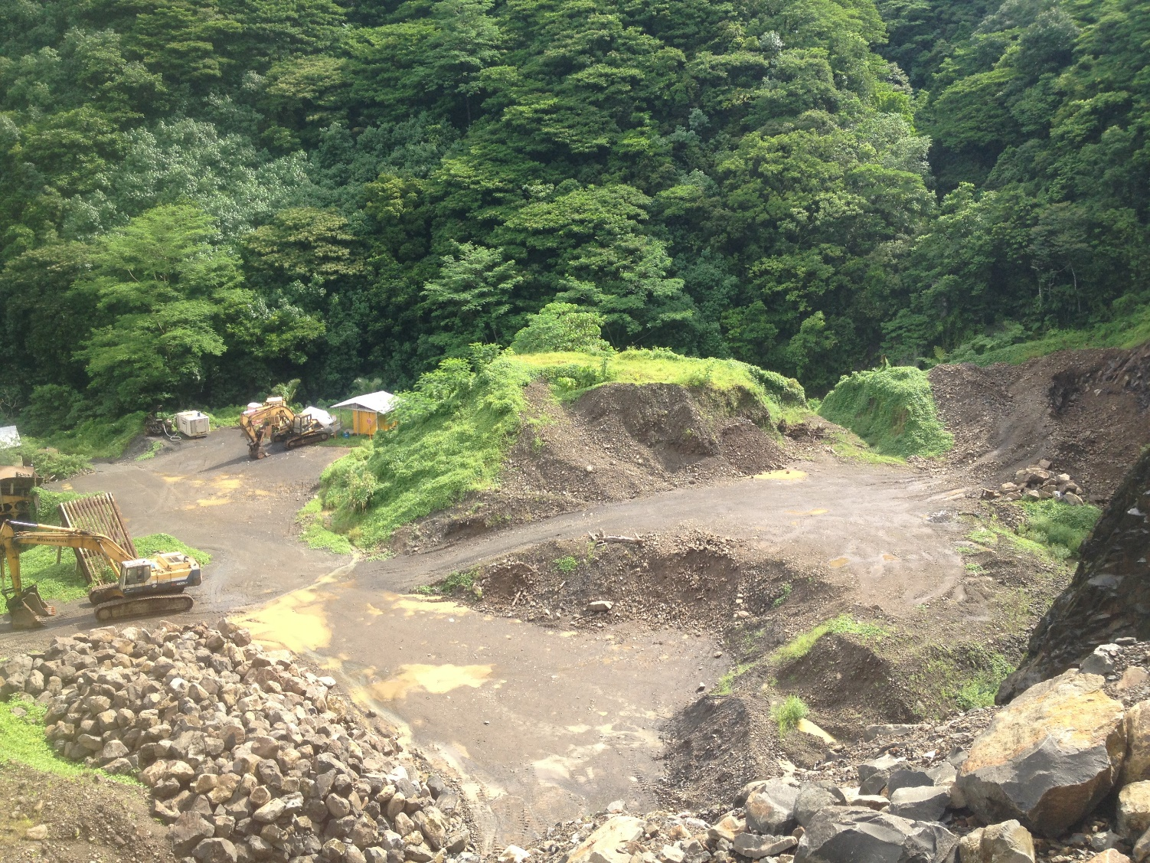
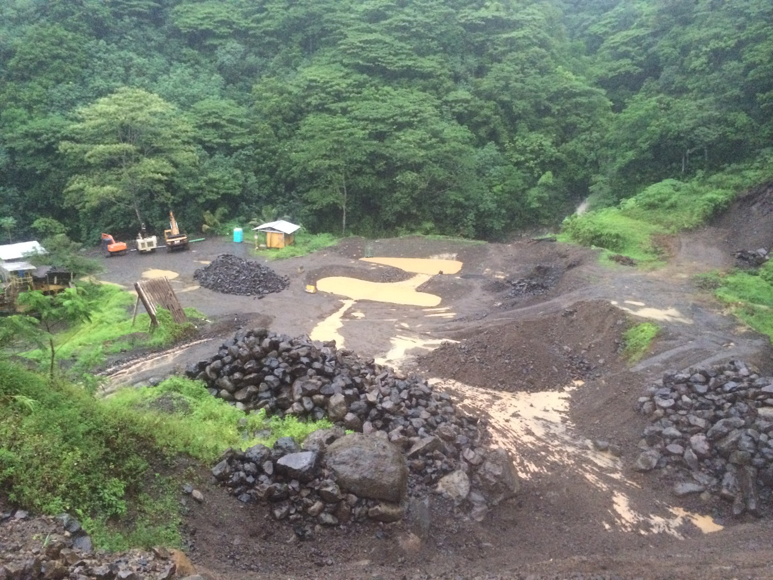

Slide 2
Upper retention pond installed 2014
Overburden pile removed 2014

Slide 3
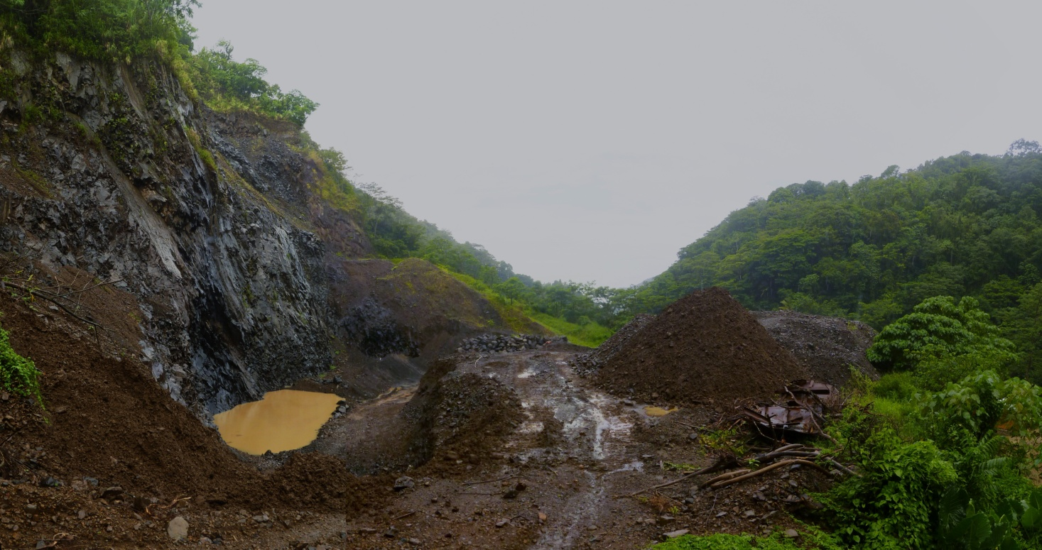
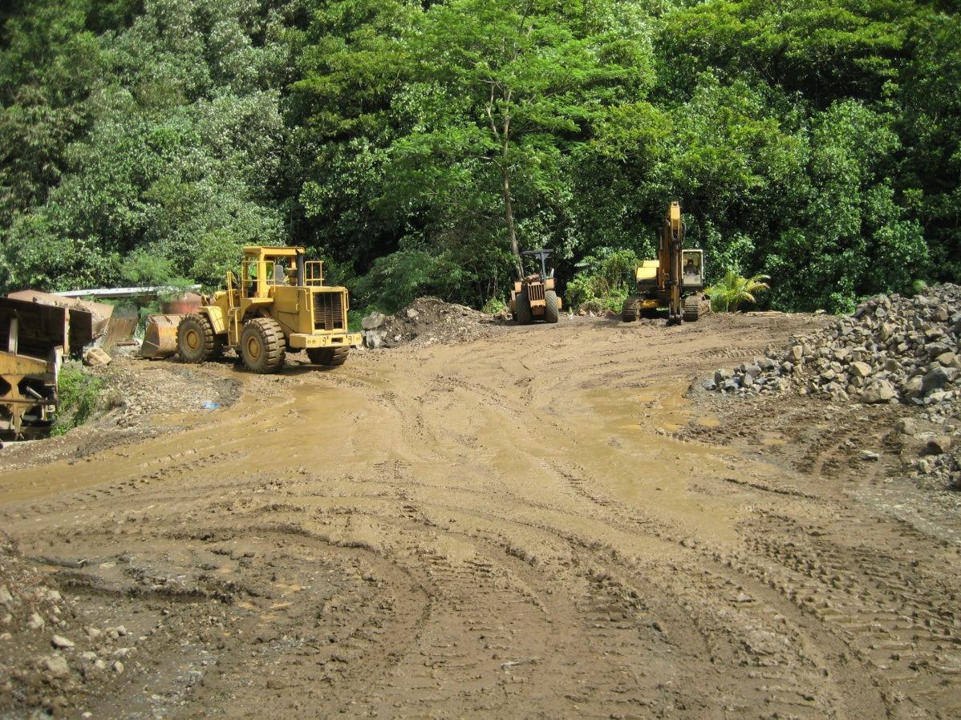
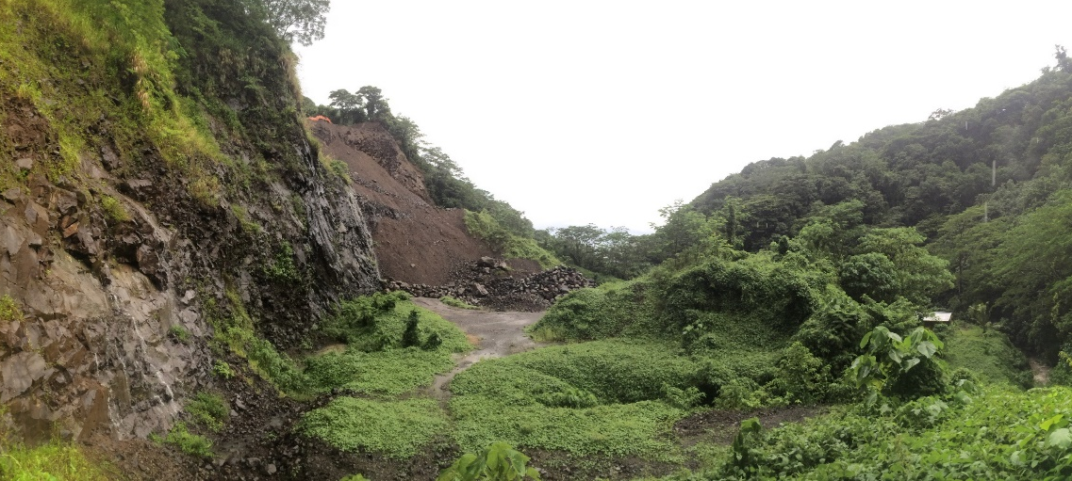
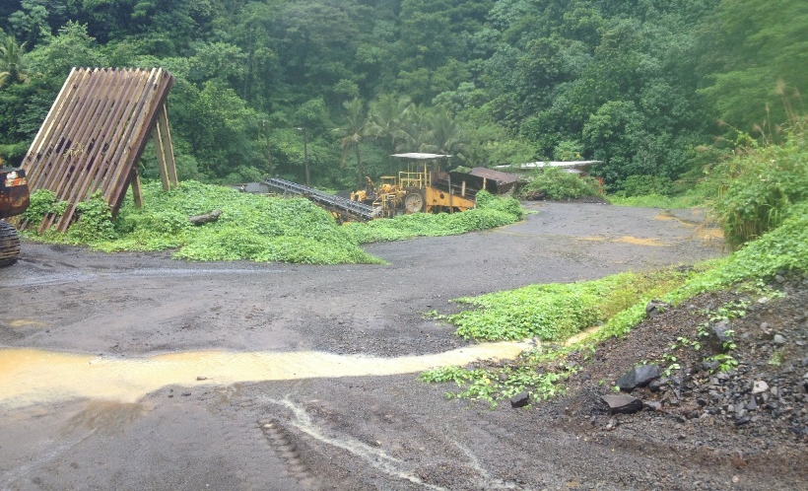
Vegetation overgrowth 2012-2014
Surfaces covered in gravel 2013
Groundwater diversion

Slide 4
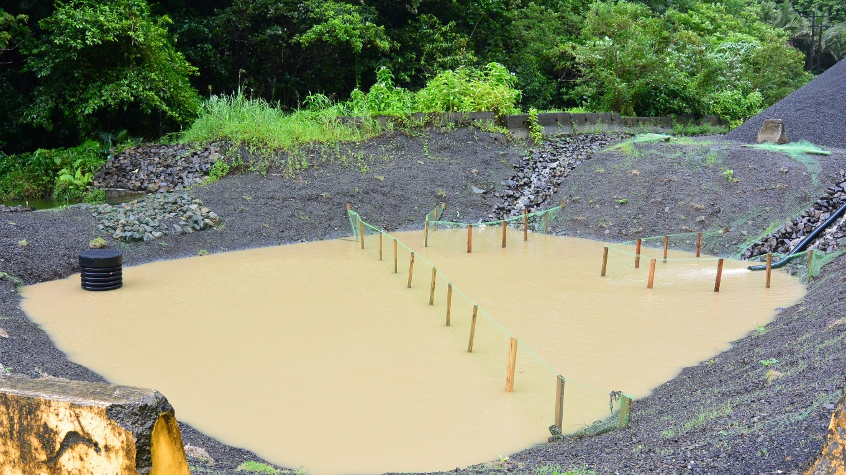

Lower retention pond
Upper retention pond

